Slide 1

True Blue in the Cafeteria
Adapted from Samuel A. Smith Elementary School
Notes:
We are placing an emphasis on being safe, responsible and respectful as a guide for how students and staff conduct themselves. We believe it is important to have set a consistent standard of excellence for what we expect of each other. Today’s lesson will focus on keeping our cafeteria a safe and enjoyable experience for staff and students. We’ll learn what we all need to do in the cafeteria to ensure that we are being True Blue.

Slide 2
True Blue Video https://www.youtube.com/watch?app=desktop&v=kQqBfo-WsTw&feature=youtu.be
Notes:
Now, we are going to watch a video with students modeling and explaining the examples of expectations. Be on the lookout for ways students are being safe, respectful, and responsible.
Show the True Blue Rollout Video with students modeling and explaining examples of the expectations. In the video, students model correct behaviors. https://youtu.be/kQqBfo-WsTw
Following the video facilitate discussion using the discussion questions. Say, What did you see students doing in the video example that demonstrates safety, respect and responsibility?
Provide behavior specific praise for students raising their hand and making contributions to the discussion

Slide 3
What did students in the video do that showed you how to be safe, respectful and responsible?
Notes:
Now, we are going to watch a video with students modeling and explaining the examples of expectations. Be on the lookout for ways students are being safe, respectful, and responsible.
Show the True Blue Rollout Video with students modeling and explaining examples of the expectations. In the video, students model correct behaviors. https://youtu.be/kQqBfo-WsTw
Following the video facilitate discussion using the discussion questions. Say, What did you see students doing in the video example that demonstrates safety, respect and responsibility?
Provide behavior specific praise for students raising their hand and making contributions to the discussion

Slide 4
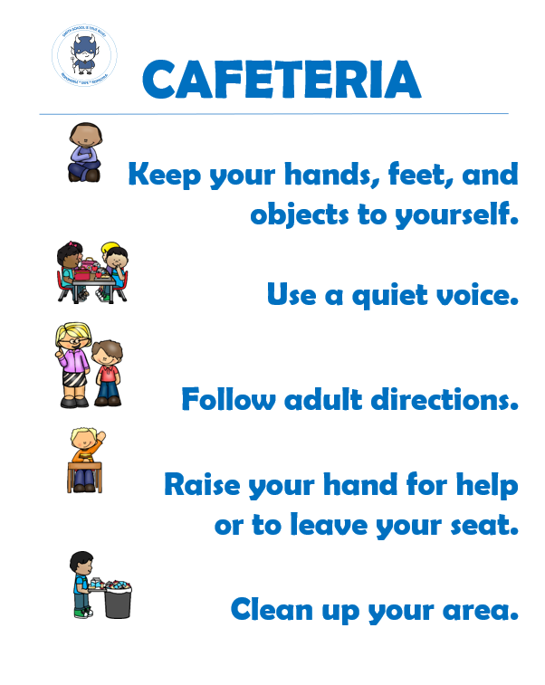
Notes:
Display and read the poster.
Say: Let’s begin by reviewing what it means to be True Blue in the Cafeteria. Please look at this poster and follow along as I read the cafeteria expectations aloud.
Keep your hands, feet, and objects to yourself.
Use a quiet voice.
Follow adult directions.
Raise your hand for help or to leave your seat.
Clean up your area.

Slide 5
True Blue
Not True Blue
Notes:
We are going to play a game! After I share an example, I want you to turn to your partner, discuss, and decide if it is an example of being True Blue or not. Then, I will ask volunteers to share what your pair decided.
After giving them time to think have them discuss the question with their neighbor. Once they’ve discussed the question, invite students to share their answers with the class. By giving them this time to process, you are enabling them to be more engaged in their learning.
One slide at a time, either an example or a non-example of being True Blue will be shown as you advance through the PowerPoint slides. After each slide, allow students to think-pair and then allow volunteers to share their decisions.
Examples:
Keep your hands, feet, and objects to yourself.
Use a quiet voice.
Follow adult directions.
Raise your hand for help or to leave your seat.
Clean up your area.
Non-examples:
Touching other students, their trays/taking their food
Yelling
Running to line up
Getting up without permission
Leaving trash/food behind
During this activity, walk around the room to check that students are on-task in their discussions.
Provide behavior specific praise (e.g., “That’s right! Cleaning up your area is an example of being True Blue in the cafeteria!”) following correctly identified examples.
If students do not correctly choose whether the item is an example or not, provide a neutral correction (e.g., “No, yelling is not an example of being True Blue in the cafeteria”) and move on to the next slide.

Slide 6

True Blue or Not True Blue?
Running to Line Up
Notes:
After giving them time to think have them discuss the question with their neighbor. Once they’ve discussed the question, invite students to share their answers with the class. By giving them this time to process, you are enabling them to be more engaged in their learning.
During this activity, walk around the room to check that students are on-task in their discussions.
Provide behavior specific praise (e.g., “That’s right! Running to line up is NOT an example of being True Blue in the cafeteria!”) following correctly identified examples.
If students do not correctly choose whether the item is an example or not, provide a neutral correction (e.g., “No, yelling is not an example of being True Blue in the cafeteria”) and move on to the next slide.

Slide 7

True Blue or Not True Blue
Touching other students, their trays or their food
Notes:
After giving them time to think have them discuss the question with their neighbor. Once they’ve discussed the question, invite students to share their answers with the class. By giving them this time to process, you are enabling them to be more engaged in their learning.
During this activity, walk around the room to check that students are on-task in their discussions.
Provide behavior specific praise (e.g., “Nice work! Touching other students, their trays or their food is NOT an example of being True Blue in the cafeteria!”) following correctly identified examples.
If students do not correctly choose whether the item is an example or not, provide a neutral correction (e.g., “No, yelling is not an example of being True Blue in the cafeteria”) and move on to the next slide.

Slide 8

True Blue or Not True Blue?
Raising your hand for help or to leave your seat
Notes:
After giving them time to think have them discuss the question with their neighbor. Once they’ve discussed the question, invite students to share their answers with the class. By giving them this time to process, you are enabling them to be more engaged in their learning.
During this activity, walk around the room to check that students are on-task in their discussions.
Provide behavior specific praise (e.g., “Yes! Raising your hand for help or to leave your seat is an example of being True Blue in the cafeteria!”) following correctly identified examples.
If students do not correctly choose whether the item is an example or not, provide a neutral correction (e.g., “No, yelling is not an example of being True Blue in the cafeteria”) and move on to the next slide.

Slide 9

True Blue or Not True Blue?
Cleaning up your area
Notes:
After giving them time to think have them discuss the question with their neighbor. Once they’ve discussed the question, invite students to share their answers with the class. By giving them this time to process, you are enabling them to be more engaged in their learning.
During this activity, walk around the room to check that students are on-task in their discussions.
Provide behavior specific praise (e.g., “Well done! Cleaning up your area is an example of being True Blue in the cafeteria!”) following correctly identified examples.
If students do not correctly choose whether the item is an example or not, provide a neutral correction (e.g., “No, yelling is not an example of being True Blue in the cafeteria”) and move on to the next slide.

Slide 10

True Blue or Not True Blue?
Following adult directions
Notes:
After giving them time to think have them discuss the question with their neighbor. Once they’ve discussed the question, invite students to share their answers with the class. By giving them this time to process, you are enabling them to be more engaged in their learning.
During this activity, walk around the room to check that students are on-task in their discussions.
Provide behavior specific praise (e.g., “That’s right! Following adult directions is an example of being True Blue in the cafeteria!”) following correctly identified examples.
If students do not correctly choose whether the item is an example or not, provide a neutral correction (e.g., “No, yelling is not an example of being True Blue in the cafeteria”) and move on to the next slide.

Slide 11

True Blue or Not True Blue?
Yelling
Notes:
After giving them time to think have them discuss the question with their neighbor. Once they’ve discussed the question, invite students to share their answers with the class. By giving them this time to process, you are enabling them to be more engaged in their learning.
During this activity, walk around the room to check that students are on-task in their discussions.
Provide behavior specific praise (e.g., “You are correct! Yelling is NOT an example of being True Blue in the cafeteria!”) following correctly identified examples.
If students do not correctly choose whether the item is an example or not, provide a neutral correction (e.g., “No, yelling is not an example of being True Blue in the cafeteria”) and move on to the next slide.

Slide 12

True Blue or Not True Blue?
Leaving trash or food behind
Notes:
After giving them time to think have them discuss the question with their neighbor. Once they’ve discussed the question, invite students to share their answers with the class. By giving them this time to process, you are enabling them to be more engaged in their learning.
During this activity, walk around the room to check that students are on-task in their discussions.
Provide behavior specific praise (e.g., “Awesome! Leaving trash or food behind is NOT an example of being True Blue in the cafeteria!”) following correctly identified examples.
If students do not correctly choose whether the item is an example or not, provide a neutral correction (e.g., “No, yelling is not an example of being True Blue in the cafeteria”) and move on to the next slide.

Slide 13

True Blue or Not True Blue?
Getting up without permission
Notes:
After giving them time to think have them discuss the question with their neighbor. Once they’ve discussed the question, invite students to share their answers with the class. By giving them this time to process, you are enabling them to be more engaged in their learning.
During this activity, walk around the room to check that students are on-task in their discussions.
Provide behavior specific praise (e.g., “That’s right! Getting up without permission is NOT an example of being True Blue in the cafeteria!”) following correctly identified examples.
If students do not correctly choose whether the item is an example or not, provide a neutral correction (e.g., “No, yelling is not an example of being True Blue in the cafeteria”) and move on to the next slide.

Slide 14

True Blue or Not True Blue?
Keeping your hands, feet and objects to yourself
Notes:
After giving them time to think have them discuss the question with their neighbor. Once they’ve discussed the question, invite students to share their answers with the class. By giving them this time to process, you are enabling them to be more engaged in their learning.
During this activity, walk around the room to check that students are on-task in their discussions.
Provide behavior specific praise (e.g., “Great! Keeping your hands, feet, and objects to yourself is an example of being True Blue in the cafeteria!”) following correctly identified examples.
If students do not correctly choose whether the item is an example or not, provide a neutral correction (e.g., “No, yelling is not an example of being True Blue in the cafeteria”) and move on to the next slide.

Slide 15
Why did you think it is important that everyone keeps their hands, feet, and objects to themselves in the cafeteria?
Notes:
Let’s talk about why we need to be safe, respectful, and responsible in the cafeteria. After I ask a question, I want you to turn to your partner and discuss. Then, I will ask volunteers to share what your pair decided.
After giving them time to think have them discuss the question with their neighbor. Once they’ve discussed the question, invite students to share their answers with the class. By giving them this time to process, you are enabling them to be more engaged in their learning.
**Provide behavior specific praise for students raising their hand and making contributions to the discussion

Slide 16
What would happen if no one cleaned up their area?
Notes:
Let’s talk about why we need to be safe, respectful, and responsible in the cafeteria. After I ask a question, I want you to turn to your partner and discuss. Then, I will ask volunteers to share what your pair decided.
After giving them time to think have them discuss the question with their neighbor. Once they’ve discussed the question, invite students to share their answers with the class. By giving them this time to process, you are enabling them to be more engaged in their learning.
**Provide behavior specific praise for students raising their hand and making contributions to the discussion

Slide 17
Why is it important to raise your hand to leave your seat?
Notes:
Let’s talk about why we need to be safe, respectful, and responsible in the cafeteria. After I ask a question, I want you to turn to your partner and discuss. Then, I will ask volunteers to share what your pair decided.
After giving them time to think have them discuss the question with their neighbor. Once they’ve discussed the question, invite students to share their answers with the class. By giving them this time to process, you are enabling them to be more engaged in their learning.
**Provide behavior specific praise for students raising their hand and making contributions to the discussion

Slide 18
What would happen if students did not use a quiet voice?
Notes:
Let’s talk about why we need to be safe, respectful, and responsible in the cafeteria. After I ask a question, I want you to turn to your partner and discuss. Then, I will ask volunteers to share what your pair decided.
After giving them time to think have them discuss the question with their neighbor. Once they’ve discussed the question, invite students to share their answers with the class. By giving them this time to process, you are enabling them to be more engaged in their learning.
**Provide behavior specific praise for students raising their hand and making contributions to the discussion

Slide 19
Why do you think it’s important for students to follow adult directions in the cafeteria?
Notes:
Let’s talk about why we need to be safe, respectful, and responsible in the cafeteria. After I ask a question, I want you to turn to your partner and discuss. Then, I will ask volunteers to share what your pair decided.
After giving them time to think have them discuss the question with their neighbor. Once they’ve discussed the question, invite students to share their answers with the class. By giving them this time to process, you are enabling them to be more engaged in their learning.
**Provide behavior specific praise for students raising their hand and making contributions to the discussion

Slide 20
Practice!
Notes:
We are going to practice how to be True Blue in the Cafeteria. Here is the poster, let’s review the expectations. Now, we will have small groups of students model the expectations for the whole group.
Examples:
Table one show us how to line up
Table two show us how to keep your hands and feet to yourself
Table three show us how you use a quiet voice when talking to your neighbor
Table four show us how to raise your hand to ask for help
Table five show us how to clean up your area
If possible, take students to the cafeteria then review the concepts on the poster.
If possible, all students practice throughout the lunch period. Note: A Team member will be in the cafeteria to assist lunch aids.
If not possible, practice in the classroom.
Provide praise: Provide specific social praise and distribute tickets for participating and attending.
General praise: “Great job following the expectations.”
Specific praise: “Sara, thank you for cleaning up your area and throwing out the garbage.”

Slide 21
Notes:
Show poster and re-read expectations.
Say: Today, we learned how to be True Blue in the Cafeteria
Keep your hands, feet, and objects to yourself.
Use a quiet voice.
Follow adult directions.
Raise your hand for help or to leave your seat.
Clean up your area.

Slide 22
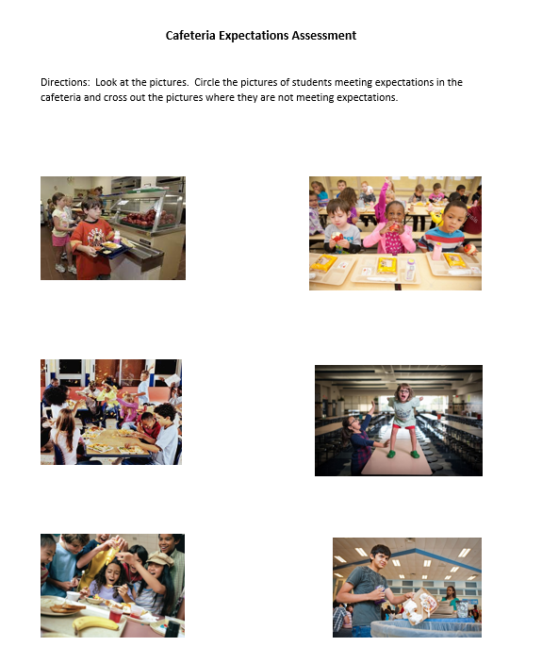
Assessment
Notes:
We have been learning today about being True Blue in the cafeteria. I want to check your understanding. For this assessment, please review each picture and circle only pictures that show students demonstrating expectations and cross out pictures that are non-examples.
Are there any questions before we get started? Do your best work and raise your hand when you are finished and I’ll collect your assessment.
Back in the classroom (or next if practiced in the classroom), provide each student with a copy of the “Cafeteria Expectations Assessment.”
Walk around to monitor worksheet completion, answer questions and give behavior specific praise
Once students are finished, collect the assessment.

Slide 23
Conclusion
Notes:
Today we learned about how we can be TRUE BLUE in the cafeteria by being responsible, safe and respectful. We can all have a great lunch period if we meet expectations.

