Slide 1
Marie Katzenbach School for the deaf peer to peer kudos

Slide 2
How do katzenbach kudos work this year?
Send a Kudos: Send a Kudos to another staff member by using this link:
Kudos can be sent to ANY staff member to recognize them for Respect, Responsibility, or Kindness
See Kudos: All Kudos that we receive are posted on the Kudos Bulletin Board.
See Prizes: See here for the list of prizes: Kudos Incentives.

Slide 3
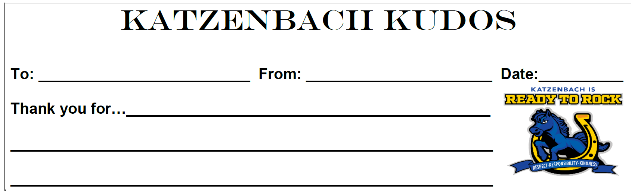
Katzenbach Peer to Peer Kudos

Slide 4
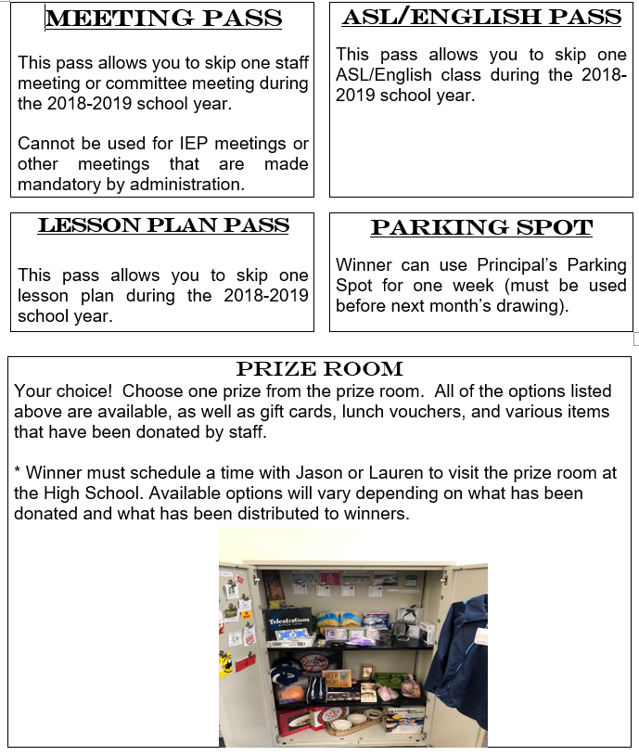
Katzenbach Staff Incentives

